Slide 1

Understanding the Difference Between JPEG and JPG
In the realm of digital imaging, JPEG (Joint Photographic Experts Group) is a widely adopted file format for compressing and storing photographs. But you might also encounter JPG. Is there a difference?

Slide 2
What is JPEG?
Lossy Compression
Widely Supported
Wide Range of Uses
JPEG uses lossy compression, meaning it discards some data to reduce file size. This results in a smaller file but can also affect image quality.
JPEG is a popular format supported by almost all image editing software, browsers, and devices.
JPEG is commonly used for photographs, digital images, and even web graphics.

Slide 3
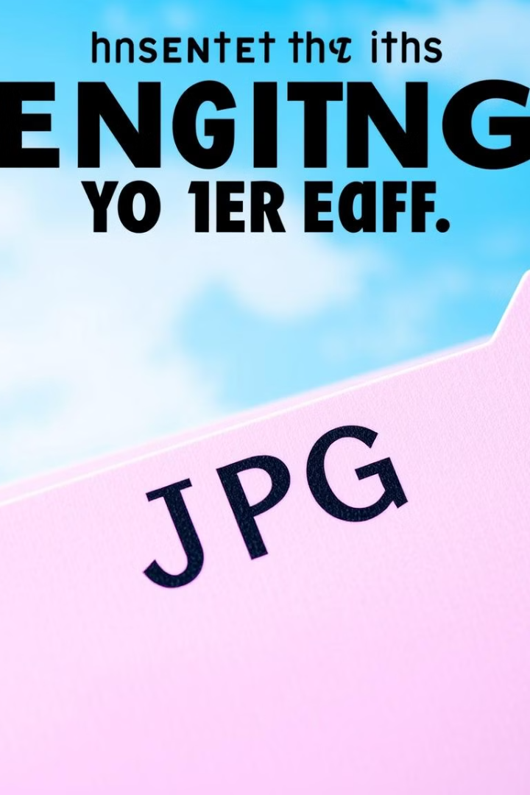
What is JPG?
JPG stands for "Joint Photographic Experts Group".
1
Just a Filename Extension
2
Same File Format
Both JPG and JPEG files use the same compression and encoding methods, resulting in identical image data.
It's essentially the same as JPEG, just a filename extension variation.
3
No Functional Difference
Regardless of the extension, the content and quality of the image remain the same.

Slide 4
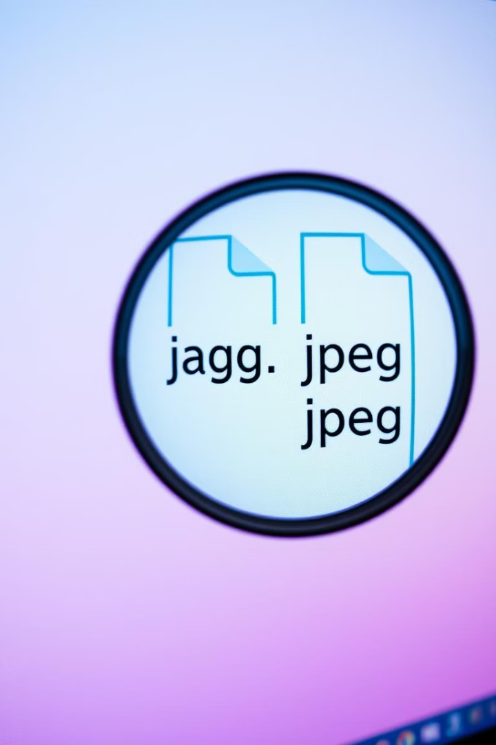



Key Differences
Filename Extension
JPEG uses the .jpeg extension while JPG uses the .jpg extension.
Historical Context
JPG was the original extension, but .jpeg was later adopted to accommodate longer filenames.
No Real Difference
Functionally, both extensions represent the same file format.

Slide 5
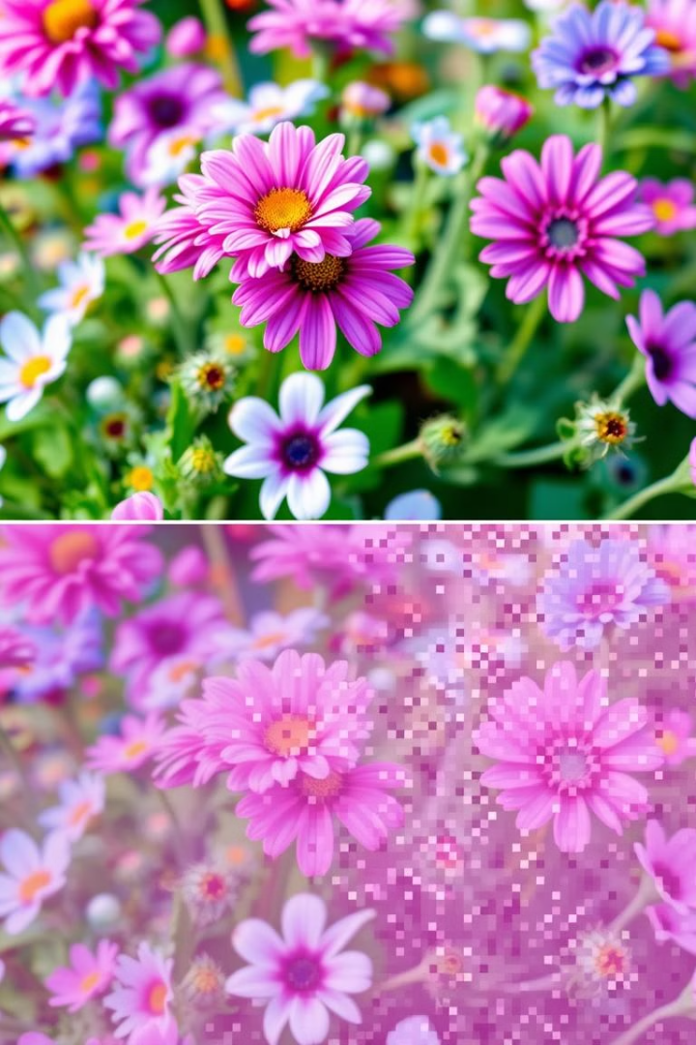
Image Quality
JPEG
JPG
JPEG offers adjustable quality levels, allowing you to balance image size and detail. Higher quality results in larger files.
JPG provides the same quality levels as JPEG, with no functional difference.

Slide 6
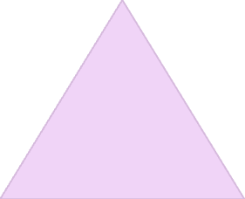


File Size
Smaller File Size
1
JPEG and JPG are known for their smaller file sizes compared to other formats, such as PNG or TIFF.
Lossy Compression
2
This is achieved through lossy compression, where some data is sacrificed to reduce file size.
Suitable for Web and Sharing
3
This makes them ideal for sharing images online and saving space on your devices.

Slide 7
Transparency Support
Limited Support
1
JPEG does not inherently support transparency. This means it cannot display transparent areas or elements.
Workarounds
2
There are workarounds using specific software or editing techniques to simulate transparency in JPEG.
Other Formats
3
For true transparency, consider using formats like PNG or GIF.

Slide 8
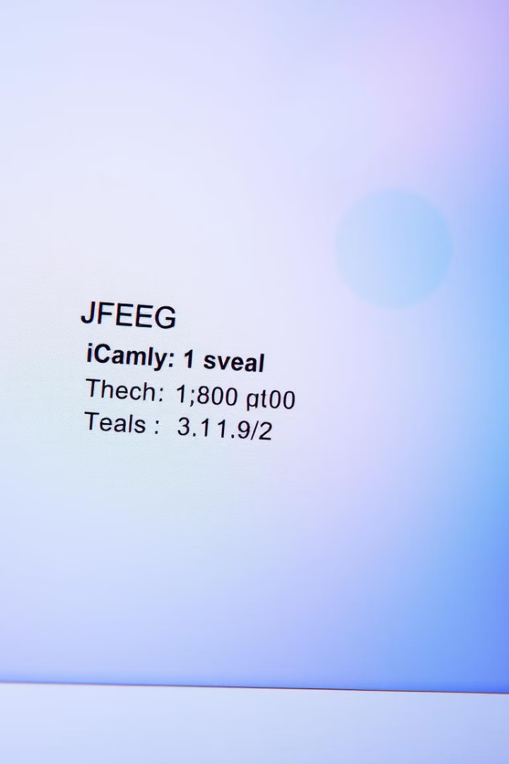
Metadata
1
Exif Data
JPEG files often contain EXIF metadata, which includes information like camera settings, date taken, and location.
2
Useful for Photography
This data can be valuable for photographers, providing insights into the image's origin and capture settings.
3
Privacy Concerns
It's essential to be aware of potential privacy implications when sharing JPEG images with metadata intact.

Slide 9



Use Cases
Photography
Web Graphics
Product Images
JPEG is the standard format for capturing and sharing photos, especially for its balance between quality and size.
JPEG's versatility makes it suitable for web images, especially when compressing large images for faster loading times.
JPEG is a popular choice for showcasing products online, as it can be compressed efficiently without sacrificing essential details.

Slide 10
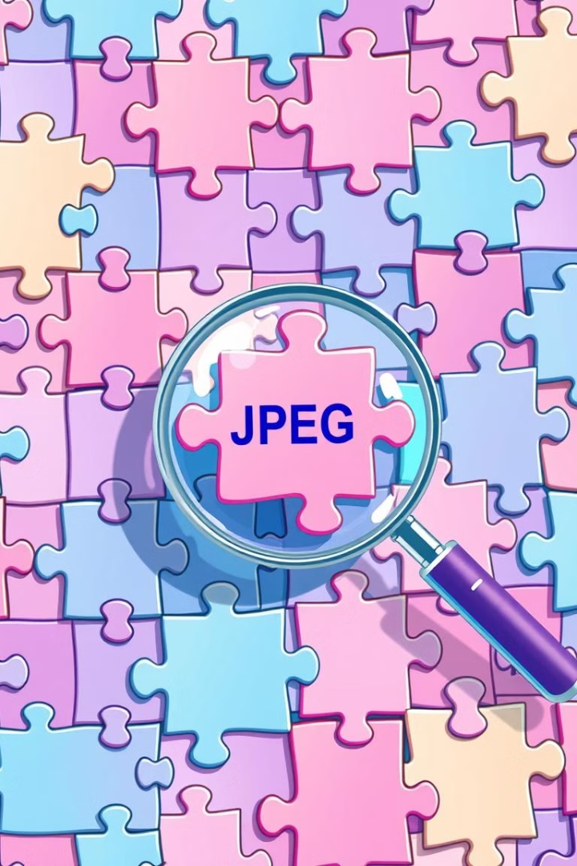
Conclusion
Both JPEG and JPG essentially refer to the same image file format. While there are slight differences in file extension, they are functionally identical. Choose JPEG or JPG based on your preference and the requirements of your specific application. Remember to carefully consider the quality and compression settings for optimal results.

